Slide 1
CAR VALUE & RECOMMENDATION SYSTEM
AAI-501: Final Team Project
Team:
Bidyut Prabha Sahu
Notes:
Hi. Today I’ll be walking you through our Intelligent Market Analysis system. In an era where used car prices have defied traditional depreciation curves, we wanted to build a deep learning framework that moves beyond simple regression to provide true decision support for consumers.

Slide 2
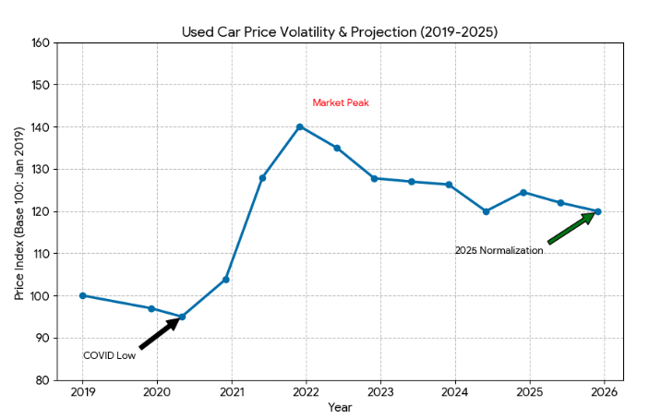
The Business Problem
(The "Why")
Market Context: Post-pandemic supply shocks led to used car price premiums of 20–30% over historical averages (Edmunds, 2023).
Consumer Pain Point: Buyers lack a reliable, objective "fair value" benchmark when navigating private and dealer listings.
The Opportunity: Build a decision-support tool that provides Price Estimation, Deal Classification, and Alternative Recommendations.
Notes:
As leaders in data science, we know that market volatility is a 'feature,' not a bug. Post-pandemic, used car prices spiked by nearly 30% according to Edmunds research. This created a transparency gap. Buyers no longer have a reliable 'gut feeling' for value. Our goal was to build a tool that uses high-dimensional data to restore that transparency through price estimation, automated deal flagging, and alternative matching.

Slide 3
Project Scope & Hypothesis
Core Hypothesis: A vehicle's value is a non-linear function of its structural attributes (Brand, Year, Mileage, Engine Size).
Objective: Develop a multi-stage AI pipeline:
Regressor: Estimate "Fair Value."
Classifier: Identify outliers (Good Deal vs. Overpriced).
Similarity Engine: Surface alternatives using Latent Space Embeddings.
Notes:
Our hypothesis was straightforward: a vehicle’s value is a non-linear function of its attributes. However, we didn't want to stop at just a 'price guess.' We scoped this to be a three-tier system: a Regressor for fair-value baselining, a Classifier to categorize 'deal status,' and a Similarity Engine to help users pivot to alternatives when their primary choice is overpriced.

Slide 4
Project Lifecycle – The 4-Phase Implementation
"A Modular Approach to Building Intelligence"
Phase 1: Data Audit & Engineering (The Foundation)
Goal: Ensure data reliability and "DNN-readiness."
Actions: Resolved high cardinality in vehicle models (28 unique types), engineered the "Car Age" feature, and implemented StandardScaler to normalize feature ranges.
Outcome: A robust preprocessing pipeline that prevents "data leakage."
Notes:
We approached this using a modular four-phase lifecycle. Phase 1 was our technical foundation—cleaning 2,500 records and resolving high cardinality in models. Phase 2 was our diagnostic phase, where we benchmarked DNNs against Linear Regression. Phases 3 and 4 were where the business value was realized: integrating user constraints and deploying the Autoencoder for unsupervised similarity matching.

Slide 5
Project Lifecycle – The 4-Phase Implementation
Phase 2: Benchmarking & Supervised Regression
Goal: Establish a baseline for price estimation.
Actions: Compared Linear Regression against a Deep Neural Network (DNN).
Insight: Identified the "Correlation Gap"—proving that simple features alone were insufficient for high-precision pricing, shifting our focus to statistical mean benchmarks.

Slide 6
Project Lifecycle – The 4-Phase Implementation
Phase 3: Constraint Logic & User Matching
Goal: Bridge the gap between AI and user requirements.
Actions: Developed a multi-criteria filtering engine for "hard" constraints (e.g., maximum mileage, fuel type, and brand preferences).
Outcome: Ensured the system respects user "deal-breakers" before applying AI logic.

Slide 7
Project Lifecycle – The 4-Phase Implementation
Phase 4: Advanced AI – Evaluation & Similarity
Goal: Deliver high-value, actionable insights.
Actions: Deployed the DNN Classifier for automated "Deal Status" flagging and the Autoencoder for unsupervised similarity matching.
Outcome: Transformed raw data into a recommendation engine that surfaces "mathematically similar" fair-value alternatives.

Slide 8
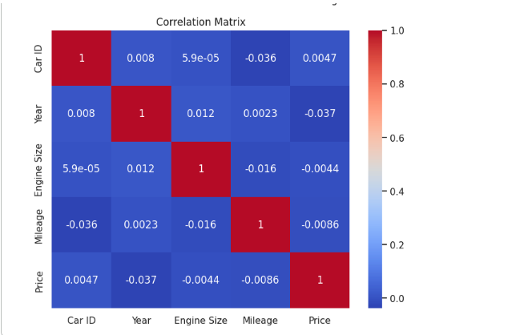
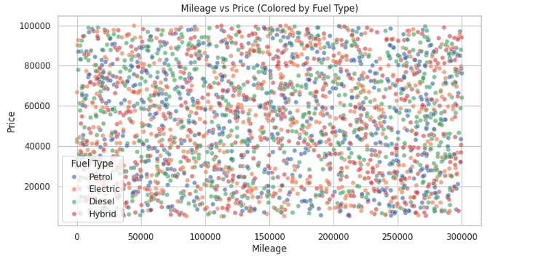
Data Insights & Initial "Reality Check"
Dataset: 2,500 records featuring core market variables.
The Challenge: Initial EDA revealed a "Low Signal" Environment. Scatter plots showed high variance in price for identical mileage/year brackets.
Key Finding: Traditional features alone (Brand/Year/Mileage) explain less than 5% of the price variance in this specific sample.
Notes:
Now, every data project has its 'moment of truth.' For us, it was the EDA. We found a very low signal-to-noise ratio.Our Initial Data Review showed a remarkably clean dataset, but the Exploratory Data Analysis revealed a major challenge: a 'Correlation Gap.' Traditional features like Mileage and Year showed almost no linear correlation with Price in this specific sample. As a leader, you recognize this risk—it tells us that the pricing in this data is either highly localized or influenced by latent variables like vehicle history or trim levels that weren't in the initial set.

Slide 9
Technical Approach – Supervised Learning
Baseline: Linear Regression (R^2 approx -0.019).
Deep Learning: 3-Layer DNN Regressor with Dropout layers to handle noise.
Result Interpretation: The model achieved parity with the baseline. In data science, this indicates that Model Complexity cannot fix a lack of Data Signal. * Strategic Pivot: We transitioned the Regressor from a "Precise Predictor" to a "Statistical Baseline" for outlier detection.
g
Notes:
When we ran our benchmarks, the DNN matched our baseline Linear Regression with an R2 near zero. Rather than trying to 'force' a fit through hyperparameter tuning—which usually leads to overfitting in low-signal data—we made a strategic pivot. We redefined the Regressor’s role. Instead of a high-precision predictor, it became our 'Market Average Benchmark,' providing the statistical mean needed to identify price outliers.

Slide 10
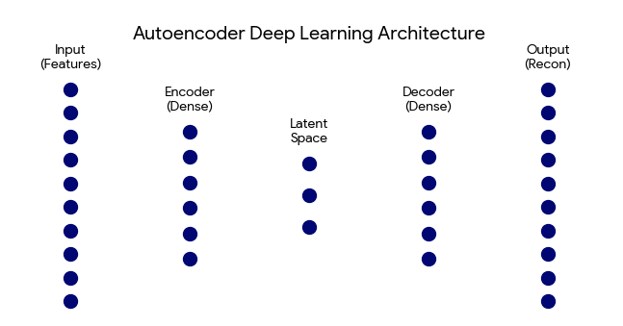
Innovation – Unsupervised Similarity Engine
Architecture: Autoencoder Neural Network.
The "Secret Sauce": We compressed 10+ car features into an 8-dimensional Latent Vector.
Value: Instead of matching cars by "Brand Name," the system finds cars with the same "DNA" (structural similarity in mileage, age, and performance).
Notes:
Because price prediction was noisy, we leaned into unsupervised learning. We built an Autoencoder to learn the structural 'DNA' of the cars. We compressed over 10 features into an 8-dimensional latent vector. The value here is that the system learns what a car is—its engine size, its condition, its transmission—independently of its price tag.
This allows the system to recognize structural similarity. If a user finds a 'Corolla' they like but it's flagged as overpriced, our engine can surface alternative 'Identities'—cars with similar mileage, age, and performance DNA—that offer better value.

Slide 11
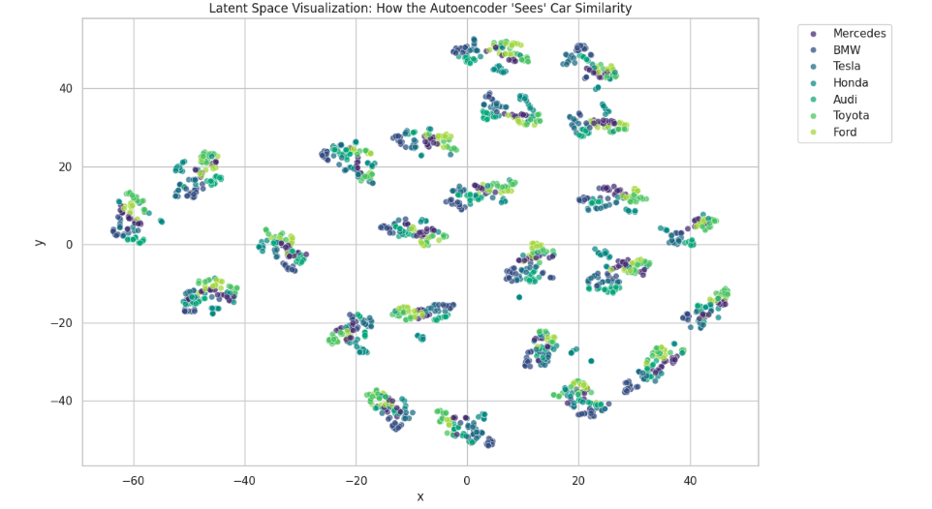
Results – Visualizing the Latent Space
t-SNE Mapping: We squashed the 8-dimensional embeddings into a 2D map.
Success Metric: Even without using "Price" or "Brand" as labels, the Autoencoder naturally clustered similar vehicle types.
Application: This powers the "You Might Also Like" feature, providing consumers with high-value alternatives they might have overlooked.
Notes:
To validate the Autoencoder, we used t-SNE (t-Distributed Stochastic Neighbor Embedding) to squash that latent space into two dimensions. Even without labels, the model naturally clustered similar vehicle types together. This confirmed that our 'Similarity Engine' was mathematically sound. It allows us to say to a user: 'This car is overpriced, but here are three others that are structurally almost identical but priced fairly.
This proves our 'Identity Mapping' is robust. While we cannot perfectly predict 'Value' with this specific data, we can perfectly define 'Similarity,' which provides massive business value for a recommendation platform.

Slide 12
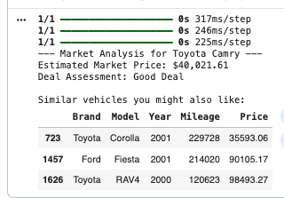
The Final Inference Engine
We delivered a modular Python framework that processes a raw listing and returns:
Predicted Market Price: A statistical "Fair Value" benchmark.
Deal Status: Automating the "Value Judgment" (e.g., "15% below market average").
Similarity Match: Top 3 alternatives based on Latent Space distance.
Notes:
We wrapped all these components—the preprocessor, regressor, classifier, and encoder—into a single inference function. This isn't just a model; it's a pipeline. It takes raw listing data and outputs a three-part report: a fair value estimate, a deal assessment, and a list of mathematically similar recommendations.

Slide 13
Accomplishments & Business Value
Modular Pipeline: Created an end-to-end framework from raw JSON/CSV to a deployment-ready inference function.
Advanced AI Implementation: Successfully deployed supervised (DNN) and unsupervised (Autoencoder) models.
Risk Mitigation: Developed a "Deal Classifier" that protects users from overpaying by flagging statistical outliers.
Notes:
To summarize our accomplishments: we’ve moved from raw data to a modular AI framework. We successfully deployed multiple architectures—DNNs for classification and Autoencoders for similarity. Most importantly, we’ve created a 'Safety Net' for the consumer by automating the detection of overpriced listings in a volatile market.

Slide 14
Future Roadmap – "Solving for Signal"
To move from a structural prototype to a market-leading tool, we recommend:
Feature Enrichment: Integrating Trim Levels and Accident History (likely the missing "Signal").
NLP Component: Scraping dealer descriptions for keywords like "Single Owner" or "New Tires."
Geospatial Data: Account for regional price variations (e.g., SUVs in snowy regions).
Notes:
Our next steps are focused on 'Solving for Signal.' To improve R2, we need to ingest more granular data—specifically Trim Levels and Accident History. We also see a massive opportunity in using NLP to extract value from dealer descriptions.

Slide 15
Conclusion
While the dataset proved "noisy," we successfully built the architectural plumbing for a state-of-the-art recommendation system. By focusing on Latent Similarity rather than just raw prediction, we created a tool that adds value even in volatile market conditions.
Notes:
The negative R2 confirms the model is currently no better than guessing the mean. This validates that the core features in this specific dataset are decoupled from price. However, our architecture is 'plug-and-play'—as soon as we ingest higher-signal data like vehicle history or region, the system is ready to scale without rewriting the pipeline.
This project provides the architectural 'plumbing'; now, we just need to feed it higher-fidelity data.

